Slide 1
Computer Graphics
Round and round

Slide 2
Previously on CG …

Slide 3

What we are going to learn !?
Drawing
CIRCLE

Slide 4
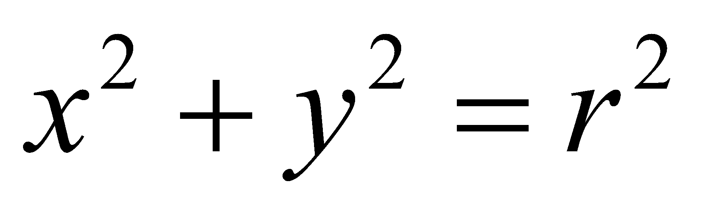
How about a circle ?
Circle equation :

Slide 5
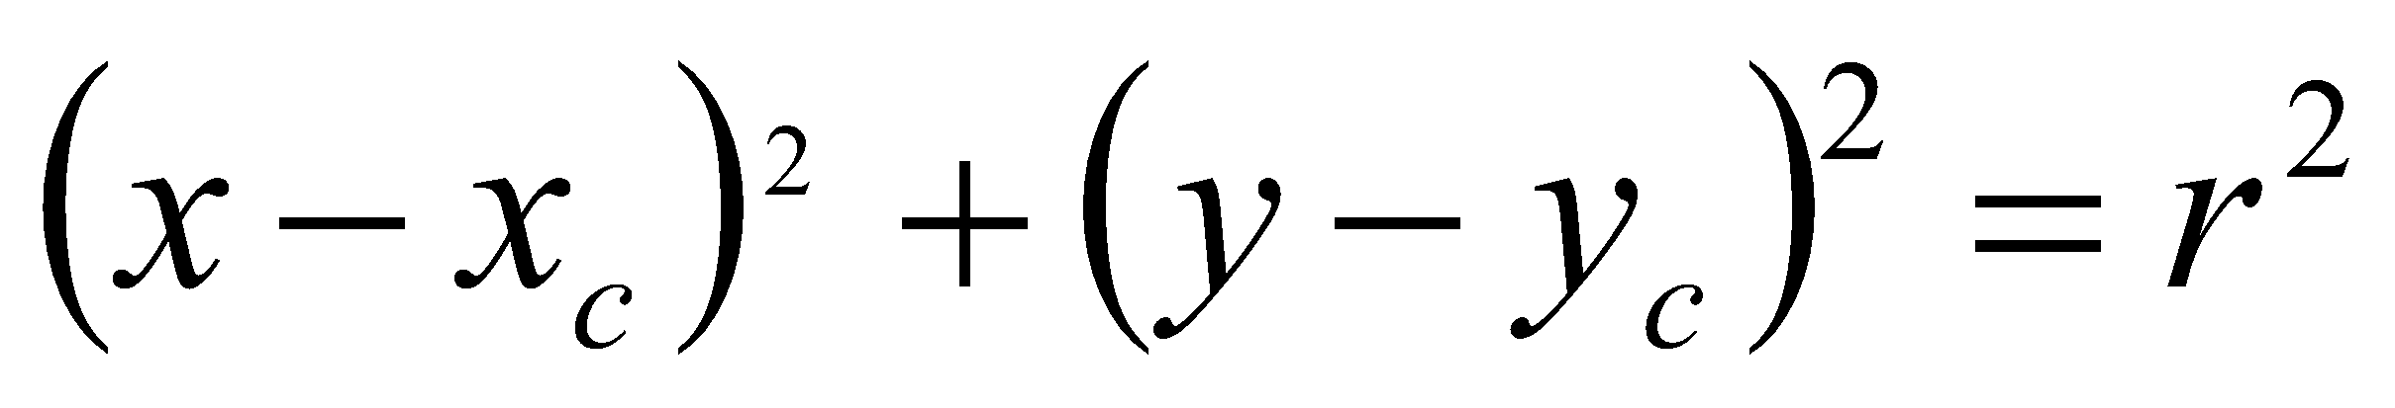
Circle with xc yc center point
(Xc,Yc)

Slide 6
Pseudo circle code
From left side of the circle to the right side of the circle
Calculate point height
Draw point (remember there is up n down height for circle)
Y2 = r2 – x2

Slide 7
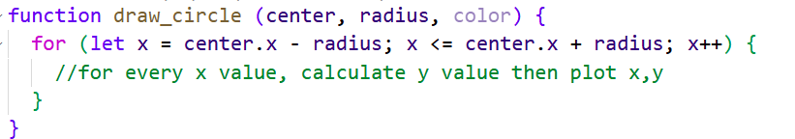

Slide 8
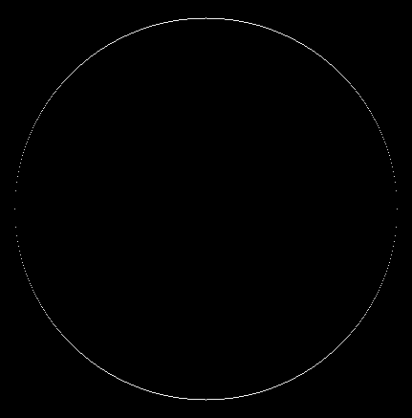
The result !!

Slide 9
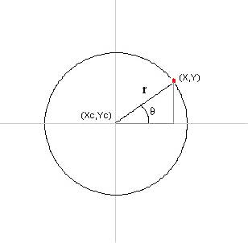
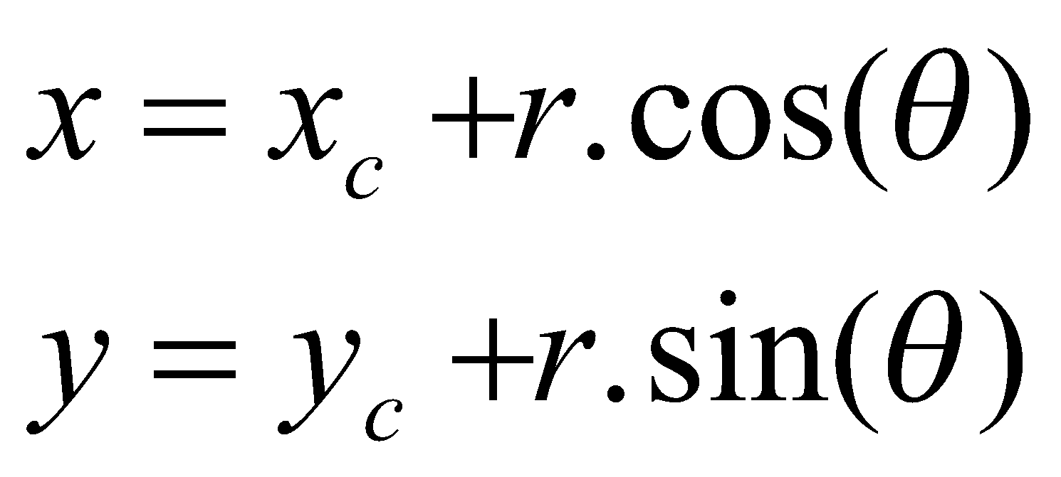
Let’s use another way
Notes:
Still remember polar coordinate ?
remember trigonometry ?

Slide 10
Pseudo circle code
From 0 degree to 360 degree (in rad)
Calculate x and y
Draw point according to x and y
Use 1 / r as degree increment for smooth circle ☺

Slide 11
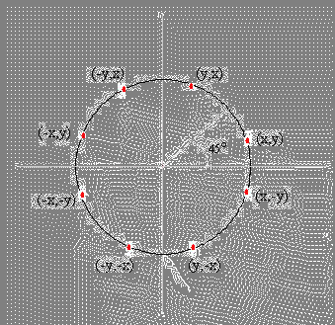
To be more efficient

Slide 12
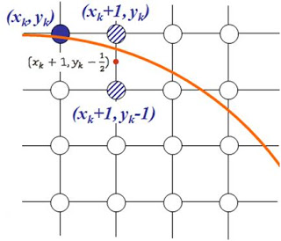
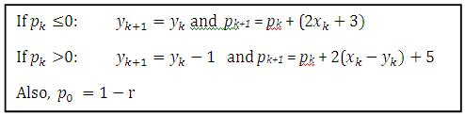
Mid point circle algorithm
Alike with bresenham line drawing algorithm
Uses integer calculation for effectiveness

Slide 13
Mid point circle algorithm
Pk = (X_{k}+1)² + (Y_{k}- ½ )² – r²
Pk = x_{k}² + 2x_{k} + 1+ y_{k}² +-y_{k} + ¼ - r²
Pk = x_{k}² + 2x_{k} + y_{k}² –y_{k} + 5/4 - r²

Slide 14
P_{k} = x_{k}² + 2x_{k} + y_{k}² –y_{k} + 5/4 - r²
P_{k +1}= x_{k+1}² + 2x_{k+1} + y_{k+1}² – y_{k+1} + 5/4 - r²
--------------------------------------------------------------------------------
P_{k +1} - P_{k} = (x_{k+1}² + 2x_{k+1} + y_{k+1}² – y_{k+1} + 5/4 - r²) – (x_{k}² + 2x_{k} + y_{k}² –y_{k} + 5/4 - r² )
Pk+1 – Pk = x_{k+1}² + 2x_{k+1} + y_{k+1}² – y_{k+1} - x_{k}² - 2x_{k} - y_{k}² + y_{k}
-

Slide 15
P_{k+1} – P_{k} = x_{k+1}² + 2x_{k+1} + y_{k+1}² – y_{k+1} - x_{k}² - 2x_{k} - y_{k}² + y_{k}
And we know that : x_{k+1} = x_{k} +1 so
P_{k+1}–P_{k}= (x_{k} +1)² + 2(x_{k}+1) + y_{k+1}² – y_{k+1} -x_{k}² - 2x_{k} - y_{k}² + y_{k}

Slide 16
P_{k+1}–P_{k}= (x_{k} +1)² + 2(x_{k}+1) + y_{k+1}² – y_{k+1} -x_{k}² - 2x_{k} - y_{k}² + y_{k}
P_{k+1}–P_{k}= (x_{k}² +2x_{k} + 1) + (2x_{k}+2) + y_{k+1}² – y_{k+1} -x_{k}² - 2x_{k} - y_{k}² + y_{k}
P_{k+1}–P_{k}= 2x_{k} +3 + y_{k+1}² – y_{k+1} - y_{k}² + y_{k}

Slide 17
P_{k+1}–P_{k}= 2x_{k} +3 + y_{k+1}² – y_{k+1} - y_{k}² + y_{k}
Pk +1 >0 🡪 yk +1 = yk-1
P_{k+1}–P_{k}= 2x_{k} +3 + (y_{k}-1)² – (y_{k}-1) - y_{k}² + y_{k}
P_{k+1}–P_{k}= 2x_{k} +3 + (y_{k}²-2y_{k} +1) – (y_{k}-1) - y_{k}² + y_{k}
P_{k+1}–P_{k}= 2x_{k} +5 + -2y_{k}
P_{k+1}–P_{k}= 2x_{k} -2y_{k} + 5 🡪 (2(x_{k} –y_{k}) + 5)
P_{k+1} = P_{k} + (2(x_{k} –y_{k}) + 5)

Slide 18
P_{k+1}–P_{k}= 2x_{k} +3 + y_{k+1}² – y_{k+1} - y_{k}² + y_{k}
Pk +1 <= 0 🡪 yk +1 = yk
P_{k+1}–P_{k}= 2x_{k} +3 + (y_{k})² – (y_{k}) - y_{k}² + y_{k}
P_{k+1}–P_{k}= 2x_{k} +3
P_{k+1}=P_{k} + 2x_{k} + 3

Slide 19
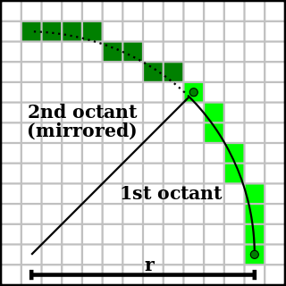

Uhmm but remember

Slide 20
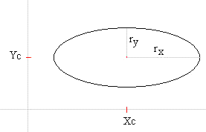

Ellipse drawing algorithm

Slide 21
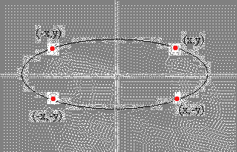
Ok let me rephrase that to polar thingy
x = xc + rx . cos(θ) y = yc + ry . sin(θ)

Slide 22
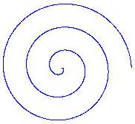
You can even make other types of form
r = 5 . θ x = xc + r . cos(θ) y = yc + r . sin(θ) 0 <= θ <= 6 . PI

Slide 23
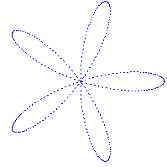
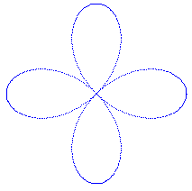
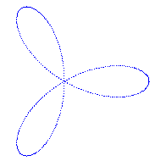
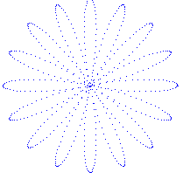
x = xc + r . cos(n . θ) . cos(θ) y = yc + r . cos(n . θ) . sin(θ) 0 <= θ <= 2 . PI
Experiment with the content of n

Slide 24
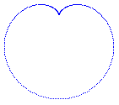
Cardiod
x = xc + (r + r . sin(θ)) . cos(θ) y = yc + (r + r . sin(θ)) . sin(θ) 0 <= θ <= 2 . PI

Slide 25
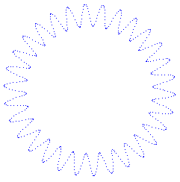
Bentuk bentuk lain
x = xc + (r + 10 . sin(Φ)) . cos(θ) y = yc + (r + 10 . sin(Φ)) . sin(θ) 0 <= θ <= 2 . PI θ adds by 1/r Φ adds by 30/r

Slide 26
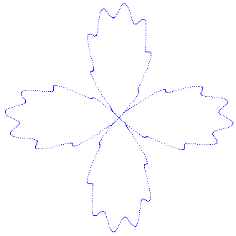
Bentuk bentuk lain
x = xc + (r . cos(2 . θ) + 10 . sin(Φ)) . cos(θ) y = yc + (r . cos(2 . θ) + 10 . sin(Φ)) . sin(θ) 0 <= θ <= 2 . PI θ adds by 1/r Φ adds by 30/r

Slide 27

Assignment
Experiment with circle drawing algorithm
and create atleast 3 new form

